Slide 1

Web-based On-demand Global NDVI Data Services
Presenter : Dayong Shen
Center for Spatial Information Science and Systems (CSISS), George Mason University

Slide 2
Source data: HDF-EOS (MOD13Q1)
-MOD13Q1 : 16-day 250-meter a gridded level-3 product in the Sinusoidal projection. It is MODIS standard product.
-We downloaded and processed the data spanning over 2000-2012.
-The datasets have prefect integrity as there is no missing date since 2000/02/18.

Slide 3
VWMS,VWCS
Web-based on-demand NDVI services
NDVI_{max},NDVI_{min},VCI_{yyyy.mm.dd} : global GeoTIFF image data

Slide 4
Flow chart
Load Tile Data
Bad Quality Filtering
Add Land/Water Mask
Big/TIFF Creation
Big/TIFF Compression
TIFF Output

Slide 5
GDAL Utilities
gdalinfo
gdal_translate
gdaladdo
gdalwarp
gdal_merge.py

Slide 6
C-C++ program
#include <sys/types.h>
#include <dirent.h>
#include <stdio.h>
#include <stdlib.h>
#include <iostream>
#include <string>
#include <errno.h>
#include "gdal_priv.h"
#include "cpl_string.h"
#include "ogr_spatialref.h"
#include "ogr_api.h"

Slide 7
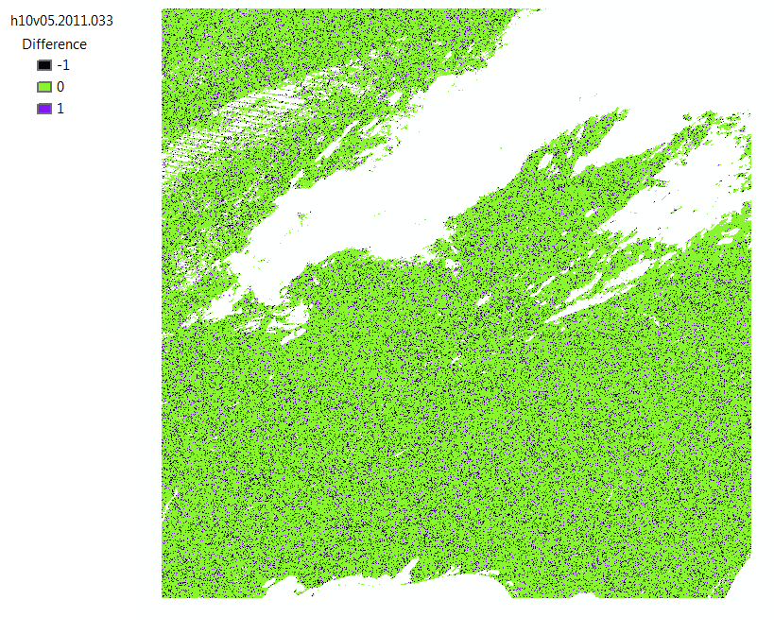

Data Quality

Slide 8
Time Test
Both VWMS and VWCS are pretty fast

Slide 9
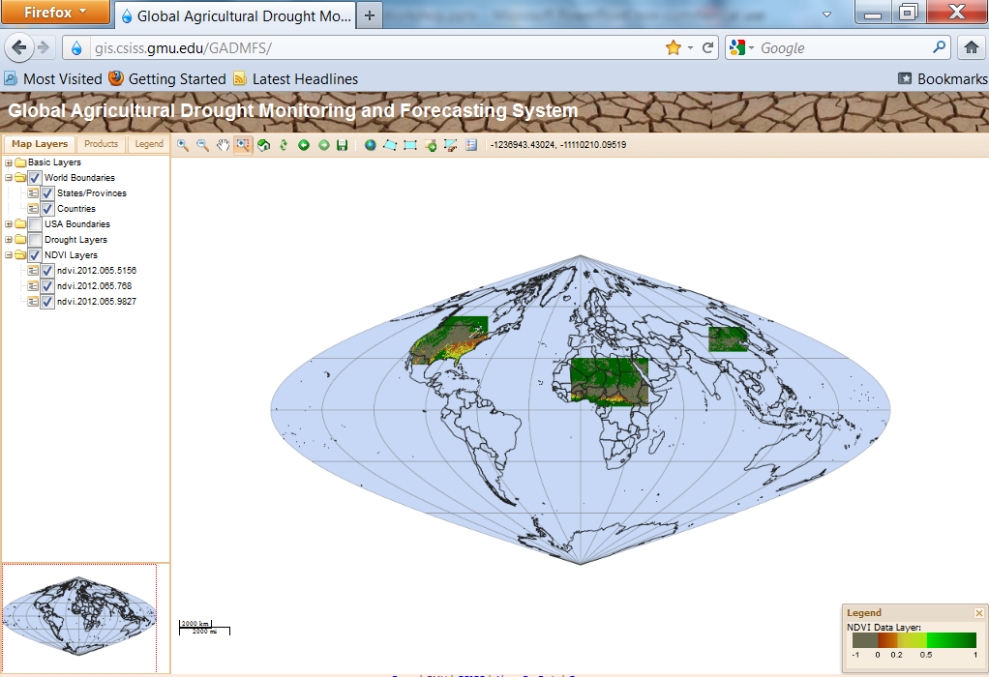
VWMS 1

Slide 10
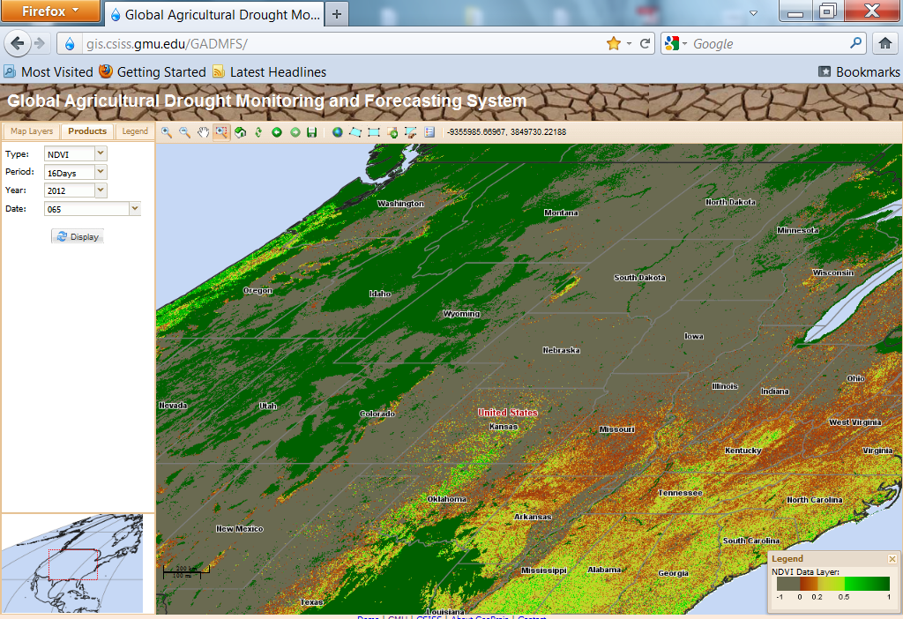
VWMS 2

Slide 11
Ongoing Work
- VWCS has been developed using C-C++, GDAL, Java and JavaScript
- VWCS Will be available on the same web portal soon

Slide 12
VWMS Web Link
http://gis.csiss.gmu.edu/GADMFS/

Slide 13
Questions and Comments?

